Slide 1

Beyond Self-Care:
Resilience as a Professional Skillset for Trauma-Informed Justice Systems
Patricia K. Kerig, Ph.D.
Dept. of Psychology, University of Utah
Center for Trauma Recovery and Juvenile Justice
National Child Traumatic Stress Network Secondary Traumatic Stress Collaborative

Slide 2
“I wouldn’t know what to say”

Slide 3
“I wouldn’t know what to say”
  How to respond helpfully to trauma disclosures
  How to cope effectively with the thoughts and feelings that arise when we learn about others’ traumas

Slide 4
How does exposure to trauma arise in the work we do?
Reading trauma-filled case histories
Performing trauma screenings
Receiving trauma disclosures
Carrying out trauma-informed programming
  justice systems
  child welfare
  mental health
  medical care
  rape crisis/domestic violence
  schools
  gang intervention
  policing/emergency/first responding
  researchers studying trauma and violence
Exposure to
others’ trauma is a potential source of trauma

Slide 5
How does exposure to trauma arise in the work we do?
  justice systems
  child welfare
  mental health
  medical care
  rape crisis/domestic violence
  schools
  gang intervention
  policing/emergency/first responding
  researchers studying trauma and violence
Exposure to others’ trauma is a po
tential source of trauma
Reading trauma-filled case histories
Trauma history screenings
Hearing trauma disclosures
Carrying out trauma-informed programming

Slide 6
How does exposure to trauma arise in the work we do?
  justice systems
  child welfare
  mental health
  medical care
  rape crisis/domestic violence
  schools
  gang intervention
  policing/emergency/first responding
  researchers studying trauma and violence
Exposure to others’ trauma is a potential source of trauma
Reading trauma-filled case histories
Trauma history screenings
Hearing trauma disclosures
Carrying out trauma-informed programming

Slide 7
Diagnostic and Statistical Manual
(DSM-5, 2013) definition of trauma:
  Exposure to actual or threatened death, serious injury, or sexual violence through
    directly experiencing
    witnessing, or
    learning about/exposure to aversive details of an event = secondary traumatic stress (STS)
  Therefore, addressing STS is a professional competency for those whose work involves traumatized individuals or trauma-related material
    Beyond personal “self-care,” skills for recognizing, preventing, and responding to STS are crucial tools in our professional toolkits

Slide 8
Diagnostic and Statistical Manual
(DSM-5, 2013) definition of trauma:
  Exposure to actual or threatened death, serious injury, or sexual violence through
    directly experiencing
    witnessing, or
    learning about/exposure to aversive details of an event = secondary traumatic stress (STS)
  Therefore, addressing STS is a professional competency for those whose work involves traumatized individuals or trauma-related material
    Beyond personal “self-care,” skills for recognizing, preventing, and responding to STS are crucial tools in our professional toolkits

Slide 9
Burnout: Emotional exhaustion and feelings of ineffectiveness due to work-related powerlessness, low appreciation
Compassion Fatigue: Feeling of being emotionally “spent” by caring for others without being able to replenish our reserves
Vicarious Trauma: Changes in inner experience due to empathic engagement with a traumatized person (may include moral injury)
Secondary Traumatic Stress: Presence of PTSD symptoms resulting from indirect exposure to others’ trauma

Slide 10
Burnout: Emotional exhaustion and feelings of ineffectiveness due to work-related powerlessness, low appreciation
Compassion Fatigue: Feeling of being emotionally “spent” by caring for others without being able to replenish our reserves
Vicarious Trauma: Changes in inner experience due to empathic engagement with a traumatized person (may include moral injury)
Secondary Traumatic Stress: Presence of PTSD symptoms resulting from indirect exposure to others’ trauma

Slide 11
Burnout: Emotional exhaustion and feelings of ineffectiveness due to work-related powerlessness, low appreciation
Compassion Fatigue: Feeling of being emotionally “spent” by caring for others without being able to replenish our reserves
Vicarious Trauma: Changes in inner experience due to empathic engagement with a traumatized person (may include moral injury)
Secondary Traumatic Stress: Presence of PTSD symptoms resulting from indirect exposure to others’ trauma

Slide 12
Burnout: Emotional exhaustion and feelings of ineffectiveness due to work-related powerlessness, low appreciation
Compassion Fatigue: Feeling of being emotionally “spent” by caring for others without being able to replenish our reserves
Vicarious Trauma: Changes in inner experience due to empathic engagement with a traumatized person (may include moral injury)
Secondary Traumatic Stress: Presence of PTSD symptoms resulting from indirect exposure to others’ trauma

Slide 13
Moral injury
“Perpetrating, failing to prevent, bearing witness to, or learning about acts that transgress deeply held moral beliefs and expectations” (Litz et al., 2009)
Moral Injury Scales for Youth (Chaplo, Kerig et al., 2019)
  Commission with agency
    “I’ve done things that break my own rules of right and wrong”
  Commission under duress
    “I’ve been forced to do things I think are wrong”
  Omission
    “I stood by and let a bad thing happen when I should have stopped it”
  Witnessing
    “I’ve seen people do terrible things”
  Betrayal
    “Someone I trusted did something I think is really wrong”

Slide 14
Burnout: Emotional exhaustion and feelings of ineffectiveness due to work-related powerlessness, low appreciation
Compassion Fatigue: Feeling of being emotionally “spent” by caring for others without being able to replenish our reserves
Vicarious Trauma: Changes in inner experience due to empathic engagement with a traumatized person (may include moral injury)
Secondary Traumatic Stress: Presence of PTSD symptoms (intrusions, avoidance, negative cognitions and mood, hyperarousal) resulting from indirect exposure to others’ trauma

Slide 15
Burnout: Emotional exhaustion and feelings of ineffectiveness due to work-related powerlessness, low appreciation
Compassion Fatigue: Feeling of being emotionally “spent” by caring for others without being able to replenish our reserves | Compassion Satisfaction: Positive feelings deriving from competence, positive relationships with coworkers, conviction one’s work makes a meaningful contribution
Vicarious Trauma: Changes in inner experience due to empathic engagement with a traumatized person (may include moral injury)
Secondary Traumatic Stress: Presence of PTSD symptoms (intrusions, avoidance, negative cognitions and mood, hyperarousal) resulting from indirect exposure to others’ trauma

Slide 16
Burnout: Emotional exhaustion and feelings of ineffectiveness due to work-related powerlessness, low appreciation
Compassion Fatigue: Feeling of being emotionally “spent” by caring for others without being able to replenish our reserves | Compassion Satisfaction: Positive feelings deriving from competence, positive relationships with coworkers, conviction one’s work makes a meaningful contribution
Vicarious Trauma: Changes in inner experience due to empathic engagement w/a traumatized person (may include moral injury) | Vicarious Resilience: Positive effects following upon witnessing another’s recovery from trauma
Secondary Traumatic Stress: Presence of PTSD symptoms (intrusions, avoidance, negative cognitions and mood, hyperarousal) resulting from indirect exposure to others’ trauma

Slide 17
Risk and Protective Factors for Secondary Traumatic Stress reactions
Risk | Protective
Isolative work environment | Connection with colleagues
Volume of trauma exposure | Support, debriefing
Empathy | Compassion satisfaction
Shame about STS | Openness and acknowledgement
Our own ACEs (Adverse Childhood Experiences) | Resolution, integration, finding meaning in past experiences
Lack of training/preparation for dealing with trauma | Trauma tools in our toolkits

Slide 18
What does Secondary Traumatic Stress look like?
Laura van Dernoot Lipsky (2009). Trauma Stewardship. San Francisco: Berrett-Kohler.
  “We are stewards not just of those who allow us into their lives, but of our own capacity to be helpful ...”

Slide 19
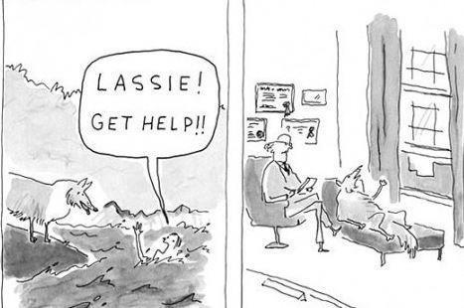
What does Secondary Traumatic Stress look like? (Lipsky, 2009)
    Feelings of helplessness/
    low self-efficacy

Slide 20
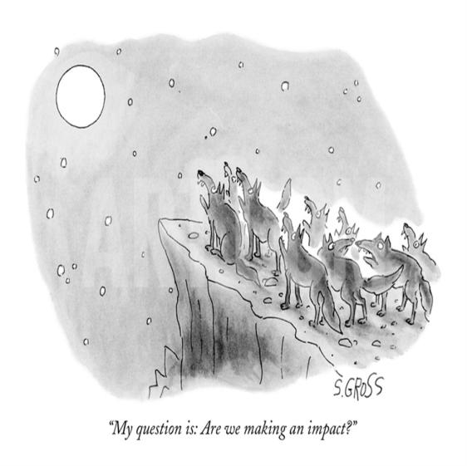
What does Secondary Traumatic Stress look like? (Lipsky, 2009)
Working so hard but feeling we aren’t doing enough
“My question is, are we making an impact?”

Slide 21
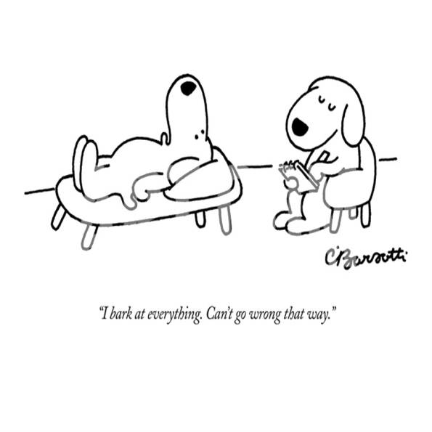
What does Secondary Traumatic Stress look like? (Lipsky, 2009)
Hypervigilance, being “always on”
“I bark at everything. Can’t go wrong that way.”

Slide 22
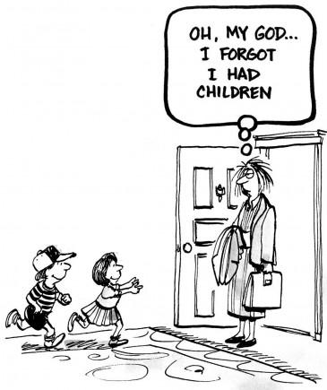
What does Secondary Traumatic Stress look like? (Lipsky, 2009)
Loss of pleasure in life

Slide 23
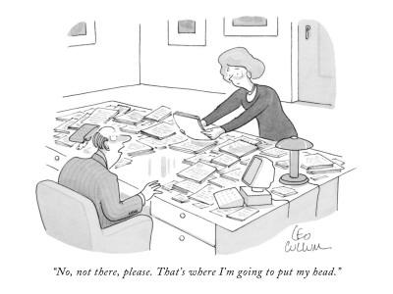
What does Secondary Traumatic Stress look like? (Lipsky, 2009)
Chronic exhaustion/
physical ailments
“No, not there please. That’s where I’m going to put my head.”

Slide 24
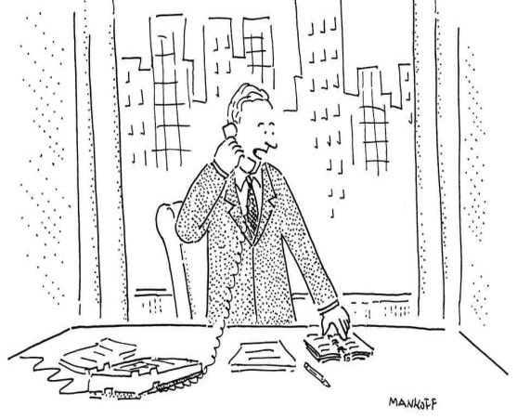
What does Secondary Traumatic Stress look like? (Lipsky, 2009)
Avoidance
“No, Thursday’s out. How about never—is never good for you?”

Slide 25
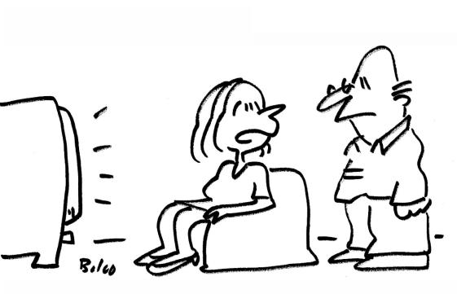
What does Secondary Traumatic Stress look like? (Lipsky, 2009)
Guilt
“Whenever I watch the Nature Channel I get survivor’s guilt.”

Slide 26
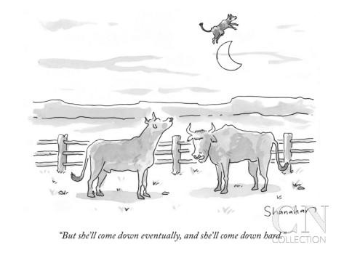
What does Secondary Traumatic Stress look like? (Lipsky, 2009)
Cynicism
“She’ll come down eventually, and she’ll come down hard.”

Slide 27
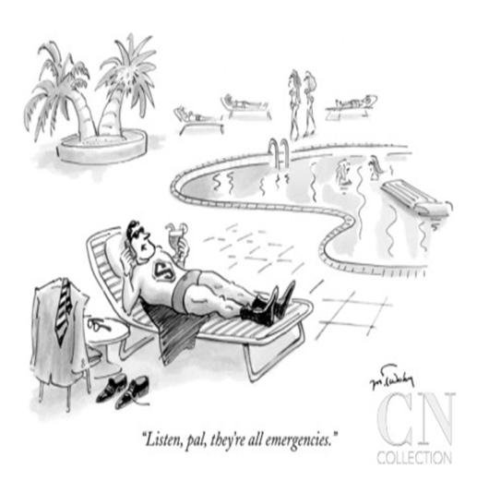
What does Secondary Traumatic Stress look like? (Lipsky, 2009)
Numbness/
Loss of empathy
“Listen pal, they’re all emergencies.”

Slide 28
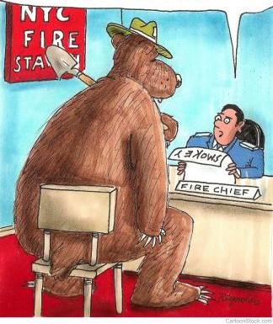
What does Secondary Traumatic Stress look like? (Lipsky, 2009)
Feeling trapped by our own indispensibility
“Your resume says ‘Only you can prevent forest fires.’
Listen pal … we work as a team here.”

Slide 29
What does Secondary Traumatic Stress look like? (Lipsky, 2009)
Helplessness/low self-efficacy
  “Though every rescue brings the knowledge of a life saved, it also brings the knowledge of countless other lives not saved. This to me feels like a personal failure.”
  --Animal rescue worker

Slide 30
What does Secondary Traumatic Stress look like? (Lipsky, 2009)
Loss of pleasure in life
  “All my energy goes into just getting through my days. I don’t do anything anymore but work and go home and watch TV.”
  --Community organizer

Slide 31
What does Secondary Traumatic Stress look like? (Lipsky, 2009)
    Hypervigilance, being “always on”
  “I recently received photos from a friend’s wedding and as I sat there looking through them, I thought to myself, ‘I wonder when the domestic violence is going to start’” --
  Domestic violence
  advocate
“I bark at everything.
Can’t go wrong that way.”

Slide 32
Signs of Secondary Traumatic Stress, vicarious trauma, and compassion fatigue
Physical
▪ Physical exhaustion
▪ Not sleeping or oversleeping
▪ Headaches, backaches, stomachaches
▪Getting sick more often (suppressed immune system)

Slide 33
Signs of Secondary Traumatic Stress, vicarious trauma, and compassion fatigue
Behavioral
▪ Increased substance use
▪ Other addictions (shopping, gambling, workaholism)
▪ Anger, irritability
▪Socially isolating
“Silencing response”
(shutting people down, changing the subject, giving “pat” answers, minimizing, cracking jokes, spacing out, not listening)

Slide 34
Signs of Secondary Traumatic Stress, vicarious trauma, and compassion fatigue
Psychological
▪ Emotional exhaustion
▪ Feeling ineffective
▪ Depressed mood
▪Reduced empathy
▪ Cynicism
▪Loss of pleasure in life
▪ Changed worldview (moral injury)
▪ Intrusions, avoidance, numbing, hypervigilance, dissociating
▪Over vs. under-sensitivity

Slide 35
Signs of Secondary Traumatic Stress, vicarious trauma, and compassion fatigue
Professional
▪ Overburdened sense of responsibility
Being “always on”
▪ Avoiding work, absenteeism
▪ Resenting demands
▪Dreading the workday
Difficulty making decisions, self-doubt
▪ Difficulty separating work and personal life

Slide 36
Signs of Secondary Traumatic Stress, vicarious trauma, and compassion fatigue
Physical
▪ Physical exhaustion
▪ Not sleeping or oversleeping
▪ Headaches, backaches, stomachaches
▪Getting sick more often (suppressed immune system)
Behavioral
▪ Increased substance use
▪ Other addictions (shopping, gambling, work)
▪ Anger, irritability
▪ Socially isolating
▪ "Silencing response"
Psychological
▪ Emotional exhaustion
▪ Feeling ineffective
▪ Depressed mood
▪ Reduced empathy
▪ Cynicism
▪ Loss of enjoyment
▪ Neg. worldview (moral injury)
▪ Intrusions, dissociating, hypervigilance, numbing
Professional
▪ Overburdened sense of responsibility
▪ Avoiding work, absenteeism
▪ Difficulty making decisions, self-doubt
▪ Resenting demands
▪ Dreading the workday
▪ Difficulty separating work and personal life
Professional
▪ Overburdened sense of responsibility
▪ Avoiding work, absenteeism
▪ Difficulty making decisions, self-doubt
▪ Resenting demands
▪ Dreading the workday
▪ Difficulty separating work and personal life

Slide 37
Strategies for self-care
Self-Care Worksheet (Saakvitne & Pearlman, 1996)
  Taking time off when I can
  Relaxing activities
  Physical exercise
  Healthy food
  Spirituality
  Social support
Professional Self-Care Scale (Dorochiak et al., 2017)
  Staying mindful of the triggers that increase my stress
  Nurturing relationships with coworkers
  Participating in activities that increase my professional growth
Notes:
Journey of discovery, prevailing noting centered around self-care
Cognitive strategies, professional support, professional development

Slide 38


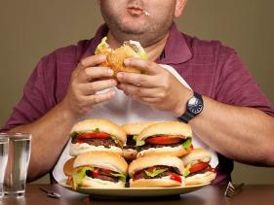

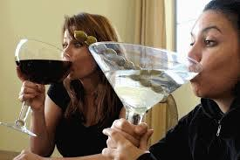
Strategies for self-care
!
Notes:
Yes those are undoubtedly good things to do, but what actually happens when stressed people go home at night? Often, we turn to what is most readily available, bingeing on comfort foods, substances, or binge-watching

Slide 39
Limits of self-care
Bober & Regher (2006) study of 246 trauma therapists:
  Participation in trainings focused on self-care did not increase time spent on self-care activities
  Time spent in self-care not associated with lower STS
Most suggested self-care activities take place long after trauma exposure and are divorced from the workplace
  We need strategies we can use in the moment, here and now (even before exposures, in anticipation)
  Integrated with our workplace environments
Focus is on solo activities
  STS is not solely an individual responsibility
  Benefits to developing a culture of care and mutual support

Slide 40
Limits of self-care
Bober & Regher (2006) study of 246 trauma therapists:
  Participation in trainings focused on self-care did not increase time spent on self-care activities
  Time spent in self-care not associated with lower STS
Most suggested self-care activities take place long after trauma exposure and are divorced from the workplace
  We need strategies we can use in the moment, here and now (even before exposures, in anticipation)
  Integrated with our workplace environments
Focus is on solo activities
  STS is not solely an individual responsibility
  Benefits to developing a culture of care and mutual support

Slide 41
Limits of self-care
Bober & Regher (2006) study of 246 trauma therapists:
  Participation in trainings focused on self-care did not increase time spent on self-care activities
  Time spent in self-care not associated with lower STS
Most suggested self-care activities take place long after trauma exposure and are divorced from the workplace
  We need strategies we can use in the moment, here and now (even before exposures, in anticipation)
  Integrated with our workplace environments
Focus is on solo activities
  Workplace STS is not solely an individual responsibility
  Benefits to developing a workplace culture of recognition and mutual support

Slide 42
Limits of self-care
Emphasis is on distracting actions, damping down emotions
  Attempts to avoid emotions can exacerbate them; experiential engagement, even with distressing emotions, is associated with recovery and regulation (Hayes, Strosahl, & Wilson, 2011)
  “Mindless” relaxation associated with default mode network → rumination, negative mood (Miller & Sprang, 2017)
Lack mindfulness and intentionality
  E.g., walking in nature may be pleasant, but recovery from STS involves doing so mindfully and intentionally to address what is underlying our STS reaction (e.g., to counter hopelessness by reminding ourselves of the power of nature’s capacities for renewal)

Slide 43
Limits of self-care
Emphasis is on distracting actions, damping down emotions
  Attempts to avoid emotions can exacerbate them; experiential engagement, even with distressing emotions, is associated with recovery and regulation (Hayes, Strosahl, & Wilson, 2011)
  “Mindless” relaxation associated with default mode network → rumination, negative mood (Miller & Sprang, 2017)
Lack mindfulness and intentionality
  E.g., walking in nature may be pleasant, but recovery from STS involves doing so mindfully and intentionally to address what is underlying our STS reaction (e.g., to counter hopelessness by reminding ourselves of the power of nature’s capacities for renewal)

Slide 44
Limits of self-care
Lack of attention to ethnic, religious, cultural diversity
  Marsella, A. J. (2010). Ethnocultural aspects of PTSD: An overview of concepts, issues, and treatments. Traumatology, 16(4). 17-26.
    Beliefs about the underlying processes disrupted by trauma:
      Biological
      Spiritual
      Interpersonal
    Destiny/fate versus personal responsibility
    Interconnectedness vs. individualism
    Patterns of coping and social resources
    Language used to encode, interpret, respond to traumatic events
    Beliefs about the processes that lead to healing
  Solo, “self”-focused activities may not be culturally relevant and may not be the most regenerative
    Giving oneself a treat vs. cooking a big dinner for neighbors and friends

Slide 45

What is resilience?
It doesn’t mean being armor-plated and impervious to all adversity

Slide 46
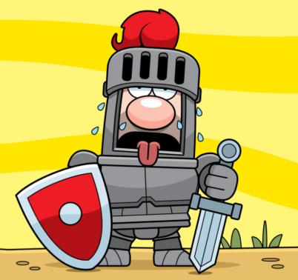
What is resilience?
It doesn’t mean being armor-plated and impervious to all adversity

Slide 47
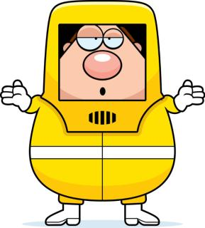
What is resilience?
It doesn’t mean wearing a psychological hazmat suit
  Having emotions related to
  our work is only human
  Emotions are a valuable tool
  in our work
    They tell us when something needs
    attending to

Slide 48
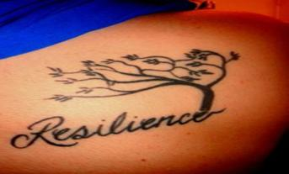
What is resilience?
Adapting—even thriving—in the face of adversity
  Resilient people are affected by their experiences
It is not all-or-none
  We can be resilient in some ways, struggling in others
It is not only a matter of our own “true grit”
  It is made up of strengths and protective factors in several domains

Slide 49
What is resilience? (Grych et al., 2015; Hamby et al., 2018)
Emotional
Emotional awareness
Meaning-making
Sense of purpose
Cultural and family values
Interpersonal
Generativity
Emotion regulation
Coping
Honesty
Optimism
Spirituality
Compassion
Social support
Community
Humility

Slide 50
What is resilience? (Grych et al., 2015; Hamby et al., 2018)
Emotional
Emotional awareness
Meaning-making
Sense of purpose
Cultural and family values
Interpersonal
Generativity
Emotion regulation
Coping
Honesty
Optimism
Spirituality
Compassion
Social support
Community
Humility

Slide 51
What is resilience? (Grych et al., 2015; Hamby et al., 2018)
Emotional
Emotional awareness
Meaning-making
Sense of purpose
Cultural and family values
Interpersonal
Generativity
Emotion regulation
Coping
Honesty
Optimism
Spirituality
Compassion
Social support
Community
Humility

Slide 52
What enables resilience in the context of STS?
Just like primary trauma exposure, secondary traumatic stress:
  Dysregulates us
    Physiologically (hyperarousal)
    Emotionally (distress)
    Cognitively (unhelpful interpretations)
    Morally (moral injury)
  Causes us to experience as if in the present something that has happened in the past the strategies that protect us will be those that:
  Re-establish our emotional, physical, cognitive, interpersonal, moral balance
  Ground us in the present
  Dispel unhelpful thoughts/interpretations
  Reconnect us to our strengths, sources of supports, and higher values

Slide 53
What enables resilience in the context of STS?
Just like primary trauma exposure, secondary traumatic stress:
  Dysregulates us
    Physiologically (hyperarousal)
    Emotionally (distress)
    Cognitively (unhelpful interpretations)
    Morally (moral injury)
  Causes us to experience as if in the present something that has happened in the past
So the strategies that protect us will be those that:
  Re-establish our emotional, physical, cognitive, interpersonal, moral balance
  Ground us in the present
  Dispel unhelpful thoughts/interpretations/judgements
  Reconnect us to our strengths, sources of supports, and values

Slide 54
R-TIP Core Principles (Kerig, 2019)
Meaning-making
Self-efficacy
Affect regulation
Prevention
Emotional awareness
Resilience, strengths-based
  Kerig, P. K. (2019). Resilience for trauma-informed professionals. Journal of Aggression, Maltreatment, & Trauma, 28, 613-630.
Notes:
R-TIP 6 core principles:
Focus should be on resilience and bolstering our strengths
Prevention, where possible
Attending to the interpretations and meanings we make of our experiences, and whether they are helpful
Maintaining a sense of self-efficacy
And allowing access to and awareness of our emotions so that we can engage effective affect regulation strategies

Slide 55
R-TIP’s tools for preventing Secondary Traumatic Stress, vicarious trauma, and compassion fatigue
Prevention
Limiting unnecessary exposure
Prior to exposure: Resilience and protection
During exposure: Tools for coping in the presence of secondary trauma exposure
After exposure: Recovery in the aftermath of stress and trauma
Protection from contagion
Minimally intrusive screening
Fostering o
Entering situation knowing we have tools in our toolboxes
Being ready to respond to disclosures
Being ready to respond if someone is triggered
Being able to ground/calm/recover our balance in the moment
Debriefing in helpful ways
Mindful self-care, self-compassion, meaning-making
Creating a social ecology of mutual awareness and support
Being prepared to make mandated reports in ways that protect clients, us, and the alliance
\ur “background” resilience
Notes:
R-TIP is organized around each of the stages of our encounters with trauma-related material

Slide 56
R-TIP’s tools for preventing Secondary Traumatic Stress, vicarious trauma, and compassion fatigue
Prevention
Limiting unnecessary exposure
Prior to exposure: Resilience and protection
During exposure: Tools for coping in the presence of secondary trauma exposure
After exposure: Recovery in the aftermath of stress and trauma
Protection from contagion
Minimally intrusive screening
Preparation and professional skill-building
Being ready to respond to disclosures
Being ready to respond if someone is triggered
Being able to ground/calm/recover our balance in the moment
Debriefing in helpful ways
Mindful self-care, self-compassion, meaning-making
Creating a social ecology of mutual awareness and support
Being prepared to make mandated reports in ways that protect clients, us, and the alliance
Entering situation knowing we have tools in our toolboxes
Creating a social ecology of mutual awareness and support

Slide 57
R-TIP’s tools for preventing Secondary Traumatic Stress, vicarious trauma, and compassion fatigue
Prevention
Limiting unnecessary exposure
Prior to exposure: Resilience and protection
During exposure: Tools for coping in the presence of secondary trauma exposure
After exposure: Recovery in the aftermath of stress and trauma
Protection from contagion
Minimally intrusive screening
Preparation and professional skill-building
Being ready to respond to disclosures
Being ready to respond if someone becomes triggered
Being able to ground/calm/recover our balance in the moment
Debriefing in helpful ways
Mindful self-care, self-compassion, meaning-making
Creating a social ecology of mutual awareness and support
Being prepared to make mandated reports in ways that protect clients, us, and the alliance
Entering situation knowing we have tools in our toolboxes
Creating a social ecology of mutual awareness and support

Slide 58
R-TIP’s tools for preventing Secondary Traumatic Stress, vicarious trauma, and compassion fatigue
Prevention
Limiting unnecessary exposure
Prior to exposure: Resilience and protection
During exposure: Tools for coping in the presence of secondary trauma exposure
After exposure: Recovery in the aftermath of stress and trauma
Protection from contagion
Minimally intrusive screening
Preparation and professional skill-building
Being ready to respond to disclosures
Being ready to respond if someone becomes triggered
Being able to ground/calm/recover our balance in the moment
Monitoring our trauma “dosage”
Being prepared to make mandated reports in ways that protect clients, us, and the alliance
Restoring our emotional, cognitive, physiological, moral and interpersonal balance
Entering situation knowing we have tools in our toolboxes
Creating a social ecology of mutual awareness and support

Slide 59
R-TIP’s tools for preventing Secondary Traumatic Stress, vicarious trauma, and compassion fatigue
Prevention
Limiting unnecessary exposure
Protection from contagion
Minimally intrusive screening

Slide 60
Prevention: Limiting unnecessary exposure
Prevention: Can staff exposure to graphic details be limited?
  Collecting information about posttraumatic reactions may not require exposure to others’ traumatic experiences
  Identifying those experiencing PTSD in the present doesn’t require asking intrusive details about what happened in the past v
    Ptsd Screening Inventory (PSI; Kerig, 2014)
      Current symptoms of PTSD, not past events
    Safety Plan (Triggers & Coping Strategies; Kerig, 2004)
      Triggers for posttraumatic reactions
      Reactions that show one has been triggered
      Coping/calming strategies that help

Slide 61
Prevention: Limiting unnecessary exposure
Prevention: Can staff exposure to graphic details be limited?
  Collecting information about posttraumatic reactions may not require exposure to others’ traumatic experiences
  Identifying those experiencing PTSD in the present doesn’t require asking intrusive details about what happened in the past v
    Ptsd Screening Inventory (PSI; Kerig, 2014)
    Triggers & Coping Strategies (Kerig, 2004)
      What triggers my posttraumatic reactions?
      What shows others I have been triggered?
      What helps?

Slide 62

Prevention: Containing contagion
When coworkers debrief or seek support after exposure to traumatic material:
  Secondary trauma is contagious, are we “passing it on”?
  Can we still benefit from getting support without sharing every graphic detail?
  Can we gently steer others from
  sharing TMI?
Limited Impact Debriefing (LID;
Mathieu, 2012; Pearlman & Saakvitne, 1995)
  Awareness
  Fair warning
  Consent
  Thoughtful disclosure

Slide 63
R-TIP’s tools for preventing Secondary Traumatic Stress, vicarious trauma, and compassion fatigue
During exposure: Tools for coping in the presence of secondary trauma exposure
Being ready to respond to disclosures
Prevention
Prior to exposure: Resilience and protection
Being ready to respond if someone is triggered
Being prepared to make mandated reports in ways that protect clients, us, and the alliance
Being able to ground/calm/recover in the moment

Slide 64
Being ready to respond in the moment to disclosures
Guidelines | What helps | What doesn’t help
1. Be present | Keep eyes focused where you usually do | Looking away, changing the subject
2. Show you’re listening | Reflect back what you’ve heard | Interpretations, questions, sharing own experiences
3. Stay calm and focused | Find a centering, calm thought to focus on in your own mind | Over-reactions, even with empathy

Slide 65
Being ready to respond if someone becomes triggered
Recognizing the signs of a triggered response
Check your own level of arousal
  Remember the airplane “oxygen mask”
Use a calm voice
Put a label on what’s happening
Invite person to engage in a self-calming or grounding exercise with you that you like and that you actually do
  Deep (“belly”) breathing
  Centering thought
  Mindfulness exercise
  Grounding with the five senses
  “Safe place” imagery
  SOS (TARGET: Julian Ford, ©University of Connecticut)
Notes:
p. 16

Slide 66
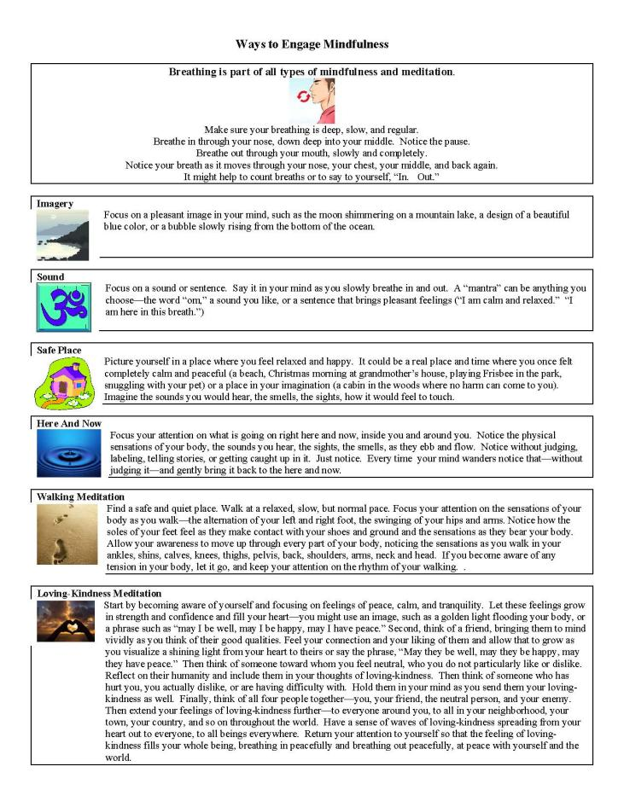
Notes:
p. 30

Slide 67
R-TIP’s tools for preventing Secondary Traumatic Stress, vicarious trauma, and compassion fatigue
Prevention
Prior to exposure: Resilience and protection
During exposure: Coping in the presence of stress, trauma and triggers
After exposure: Recovery in the aftermath of trauma
Restoring our emotional, cognitive, physiological, moral and interpersonal balance
Monitoring our trauma “dosage”

Slide 68
Developing an early warning system
Green zone
Yellow zone
Red zone
Your “dosimeter”
What signs do you experience most at work?
What signs do you bring home most often?
Who can partner with you on this?
  Who knows you, maybe even better than you do?
  Who can help you monitor your “dosage” when you are not aware?
Notes:
p. 23

Slide 69
Restoring balance after trauma exposure
While at work
  How do you ground yourself/regulate your emotions while participants/clients/coworkers are talking about trauma?
  What do you do to re-ground yourself after being shaken up by someone’s traumatic story?
  How do you know you’re ready to get back to work?
In the transition between work and home
  What do you do at the end of the workday to put difficult stories in their context before you go home?
At home
  How do you recharge your batteries?
In the longer term
  What preserves your sense of purpose, meaning, and satisfaction in the work you do?

Slide 70
Restoring balance after trauma exposure
While at work
  How do you ground yourself/regulate your emotions while participants/clients/coworkers are talking about trauma?
  What do you do to re-ground yourself after being shaken up by someone’s traumatic story?
  How do you know you’re ready to get back to work?
In the transition between work and home
  What do you do at the end of the workday to put difficult stories behind you before you go home?
At home
  How do you recharge your batteries?
In the longer term
  What preserves your sense of purpose, meaning, and satisfaction in the work you do?

Slide 71
Restoring balance after trauma exposure
While at work
  How do you ground yourself/regulate your emotions while participants/clients/coworkers are talking about trauma?
  What do you do to re-ground yourself after being shaken up by someone’s traumatic story?
  How do you know you’re ready to get back to work?
In the transition between work and home
  What do you do at the end of the workday to put difficult stories behind you before you go home?
At home
  How do you recharge your batteries?
In the longer term
  What preserves your sense of purpose, meaning, and satisfaction in the work you do?

Slide 72
Restoring balance after trauma exposure
While at work
  How do you ground yourself/regulate your emotions while participants/clients/coworkers are talking about trauma?
  What do you do to re-ground yourself after being shaken up by someone’s traumatic story?
  How do you know you’re ready to get back to work?
In the transition between work and home
  What do you do at the end of the workday to put difficult stories behind you before you go home?
At home
  How do you recharge your batteries?
In the longer term
  What preserves your sense of purpose, meaning, and satisfaction in the work you do?

Slide 73
My personal STS protection toolkit
What are my key warning signs? | What lets me know I’m in my green zone? | What do I look like when I’m in my yellow zone? |  | What do I look like when I’m in my red zone?
Regular, weekly self-check, engaging others I trust who know me well | When? | Where? |  | With whom?
In anticipation: Strategies that help me prepare for exposures | Mindfulness: | Mental rehearsal: |  | Support/consultation:
During exposure: Strategies for maintaining balance | Calming, centering, regulating: |  | Emotional awareness/acceptance:
After exposure: Balance-restoring/self-regulation strategies I’ll actually use | While I’m still at work: | Transition between work and home: |  | At home:
Stress resilience and prevention strategies for the longer term | What recharges my batteries? | What helps me stay physically and emotionally healthy? |  | How do I nurture my compassion satisfaction?

Slide 74
Activity: Tapping into our compassion satisfaction
In the midst of stress, it helps to take the time to step back and remember WHY we are doing this work and what keeps us going (adapted from Volk et al., 2008)
Think about the most rewarding moment you’ve had doing this work.
What are three things that you love about this work?
Describe one person whose life you have touched through this work.
What is the best compliment you've received from a coworker, or something you know you do well?
Notes:
Last, one more activity.
As we’ve discussed, one of the most powerful antidotes to compassion fatigue is compassion satisfaction.
Look at these four questions and pick ONE that does the best job of bringing to your mind something that helps you remember why you are doing this work and what it is that keeps you going.

Slide 75
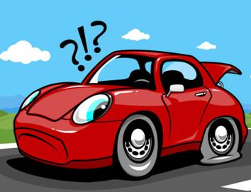
What gets in the way of engaging in resilience-promotion?
Thinking “self-care” = “selfish”
  We can best help others when we are clear-thinking, calm, and healthy ourselves
  “We have an obligation to our clients, as well as to ourselves, our colleagues and our loved ones, not to be damaged by the work we do” (Saakvitne et al., 1996)
Waiting too long to use the tools in our toolboxes
Not practicing what we preach
  Self-regulation skills don’t work
  unless we actively use them!
  Just reading about them is like
  trying to fix a flat tire by reading
  your car’s owner’s manual
  (Mathieu, 2012)

Slide 76
Addressing STS is a multi-pronged effort
Professional skills
Trauma training
Debriefing
Organizational
Supervision
Acknowledging STS
Personal
Self-care
Resilience
Work/life balance
Providing supports
Limiting trauma inputs
Balancing task assignments

Slide 77
R-TIP’s tools for preventing Secondary Traumatic Stress, vicarious trauma, and compassion fatigue
Prevention
Prior to exposure: Resilience and protection
During exposure: Coping in the presence of stress, trauma and triggers
After exposure: Recovery in the aftermath of trauma
Preparation and professional skill-building
Entering situation knowing we have tools in our toolboxes
Creating a social ecology of mutual awareness and support

Slide 78
Developing a mutually-supportive, STS-aware social ecology in the workplace
“Buddy system”
  Sharing “yellow zone” signs and signals
  Accountability for holding to weekly self-checks
  Commitment to practicing LID
Supporting one another in taking breaks
  Share lunchtime with coworkers
  Invite someone to take a brief walk on a mini-break
    “Walk-Talk-Flush” (Diana Tikasz, TEND Academy)
Check-in with coworker who had a rough day
Make a point to give a compliment each day, acknowledge a “job well done”

Slide 79
Organizational strategies:
Preventing, monitoring, responding
STS Acknowledgment and Ongoing Assessment
Trauma-Informed Supervision
Psychoeducation and Training
Organizational Wellness Practices
Risk Reduction
Promoting Compassion Satisfaction
Climate of Mutual Support
Access to Resources,
Supports, Referrals

Slide 80
Resources: Organizational strategies
STS Committee of the National Child Traumatic Stress Network: Essential Elements of an STS-Informed System (nctsn.org)
Secondary Traumatic Stress Informed Organizational Assessment (STSI-OA; Sprang et al., 2018, http://www.uky.edu/CTAC/STSI-OA)
STS Core Competencies in Trauma-Informed Supervision (https://www.nctsn.org/resources/using-secondary-traumatic-stress-core-competencies-trauma-informed-supervision)

Slide 81
Resources: Intervening with STS
Figley, C. R. (2002). Treating compassion fatigue. New York: Brunner-Routledge.
Gentry, J. E., Baggerly, J., & Baranowsky, A. (2004). Training-as-treatment: Effectiveness of the Certified Compassion Fatigue Specialist Training. IJEMH, 6(3), 147-155.
Kabat-Zinn, J. (2006). Mindfulness for beginners. Sounds True.
Kerig, P. K. (2019). R-TIP: Resilience for trauma-informed professionals. Journal of Aggression, Maltreatment, & Trauma, 28, 613-630.
Macbeth, J. (1990). Moon over water. Gateway Books.
Mathieu, F. (2012). The compassion fatigue workbook. New York: Routledge.
McCann, I. L., & Pearlman, L. A. (1990). Vicarious traumatization: A framework for understanding the psychological effects of working with victims. Journal of Traumatic Stress, 3, 131-149.
Miller, B., & Sprang, G. (2017). A components-based practice and supervision model for reducing compassion fatigue by affecting clinician experience. Traumatology, 23(2), 153-164.
Neff, K., & Germer, C. (2018). The mindful self-compassion workbook. New York: Guilford.
Posen, D. (2013). Little book of stress relief. Firefly Books.
Skovholt, T. M., & Trotter-Mathison, M. (2016). The resilient practitioner. New York: Routledge.
Stamm, B. H. (1999). Secondary traumatic stress: Self-care issues for clinicians, researchers, and educators. Lutherville, MD: Sidran Press.
Van Dernoot Lipsky, L. (2009). Trauma stewardship: An everyday guide to caring for self while caring for others. San Francisco: Berrett-Koehler.
Vo, D. X. (2015). The mindful teen: Powerful skills to help you handle stress one moment at a time. Oakland, CA: New Harbinger.
Volk, K. T., Guarino, K., Grandin, M. E. & Clervil, R. (2008). What about you? A workbook for those who work with others. Newton Centre, MA: National Center on Family Homelessness
Wicks, R. J. (2008). The resilient clinician. New York: Oxford University Press.

Slide 82
Resources: Research on STS
Bercier, M. L., & Maynard, B. R. (2015). Interventions for secondary traumatic stress with mental health workers: A systematic review. Research on Social Work Practice, 25(1), 81-89.
Berger, R., & Gelkopf, M. (2011). An intervention for reducing secondary traumatization and improving professional self-efficacy in well baby clinic nurses following war and terror: A random control group trial. International Journal of Nursing Studies, 48(5), 601-610.
Bober, T., & Regehr, C. (2006). Strategies for reducing secondary or vicarious trauma: Do they work? Brief Treatment and Crisis Intervention, 6(1), 1-9.
Flarity, K., Gentry, J. E., & Mesnikoff, N. (2013). The effectiveness of an educational program on preventing and treating compassion fatigue in emergency nurses. Advanced emergency nursing journal, 35(3), 247-258.
Ivicic, R., & Motta, R. (2017). Variables associated with secondary traumatic stress among mental health professionals. Traumatology, 23(2), 196-204.
Molnar, B. E., Sprang, G., Killian, K. D., Gottfried, R., Emery, V., & Bride, B. E. (2017). Advancing science and practice for vicarious traumatization/secondary traumatic stress: A research agenda. Traumatology, 23(2), 129-142.
Newell, J. M., Nelson-Gardell, D., & MacNeil, G. (2016). Clinician responses to client traumas: A chronological review of constructs and terminology. Trauma, Violence, & Abuse, 17(3), 306-313.
Prati, G., Pietrantoni, L., & Cicognani, E. (2010). Self-efficacy moderates the relationship between stress appraisal and quality of life among rescue workers. Anxiety, Stress, & Coping, 23(4), 463-470.
Sprang, G., Ross, L., Miller, B. C., Blackshear, K., & Ascienzo, S. (2017). Psychometric properties of the Secondary Traumatic Stress–Informed Organizational Assessment. Traumatology, 23(2), 165-171.
Udipi, S., Veach, P. M., Kao, J., & LeRoy, B. S. (2008). The psychic costs of empathic engagement: Personal and demographic predictors of genetic counselor compassion fatigue. Journal of Genetic Counseling, 17(5), 459-471.
Walsh, C. R., Mathieu, F., & Hendricks, A. (2017). Report from the Secondary Traumatic Stress San Diego Think Tank. Traumatology, 23(2), 124-128.

Slide 83
Thank you!
p.kerig@utah.edu
Notes:
And, last but not least, thank you! From me and the Lorax. I’ll be happy to respond to any questions or comments.

