Slide 1

Probation Case Planning that is Youth-Centered,
Family-Focused and Strength-Based
FEBRUARY 1 2018

Slide 2



If we were creating the juvenile justice system from scratch with the intention of developing youth, supporting families, not doing harm, restoring victims, and increasing public safety, it is unlikely that system would have any resemblance to what exists today.
A Positive Youth
Justice System
“
“

Slide 3

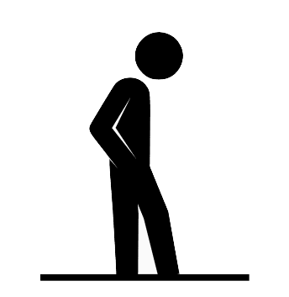

A Positive Youth
Justice System
Overwhelming evidence shows that involvement in the juvenile justice system in and of itself produces negative outcomes for young people.
1899
When the first juvenile court was established in 1899, its purpose was to create a system separate from the criminal court to meet youth needs rather than punish their acts.
With reform efforts moving in the right direction, how do we establish a juvenile justice system that reflects the original intentions of the juvenile court, and provide the kind of support and guidance our youth deserve.

Slide 4



A Positive Youth
Justice System
Numerous studies have found that involvement in the juvenile justice system alone, even while controlling for other factors, causes youth to have worse outcomes
One study that rigorously examined the effects of the juvenile justice system found that incarceration itself resulted in negative consequences for youth (Aizer and Doyle, 2015). The report states, “juvenile incarceration results in large decreases in the likelihood of high school completion and large increases in the likelihood of adult incarceration.”
Another study found that doing nothing with youth who commit delinquent acts resulted in better outcomes than placing youth in the juvenile justice system (Gatti, Tremblay and Vitar, 2009).

Slide 5
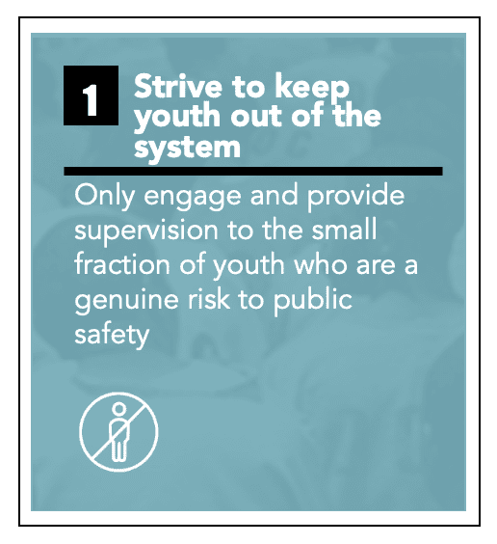
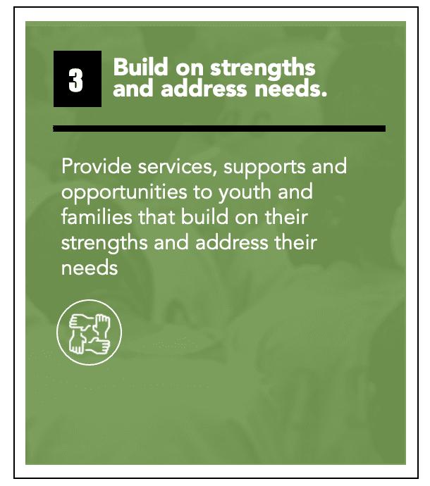
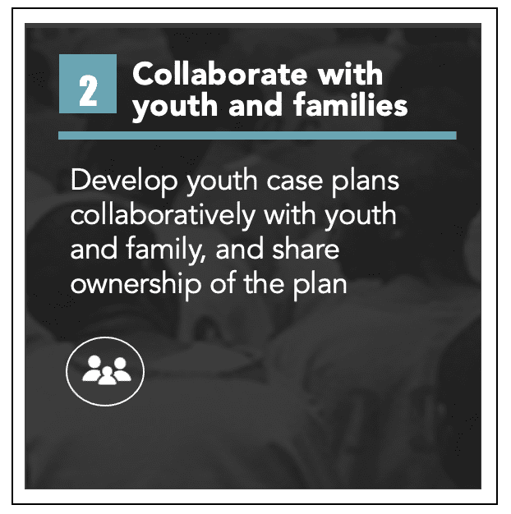
A Positive Youth
Justice System
Notes:
DAVID slide

Slide 6
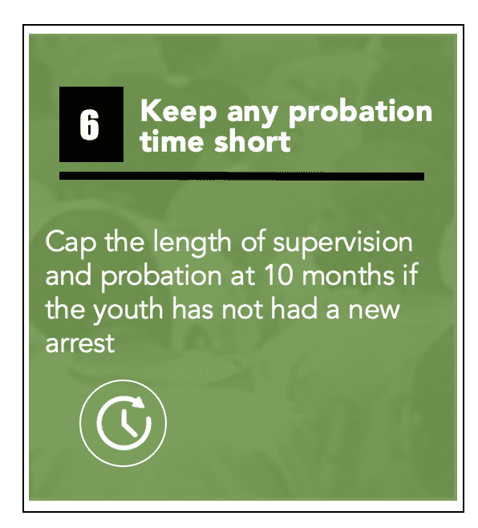
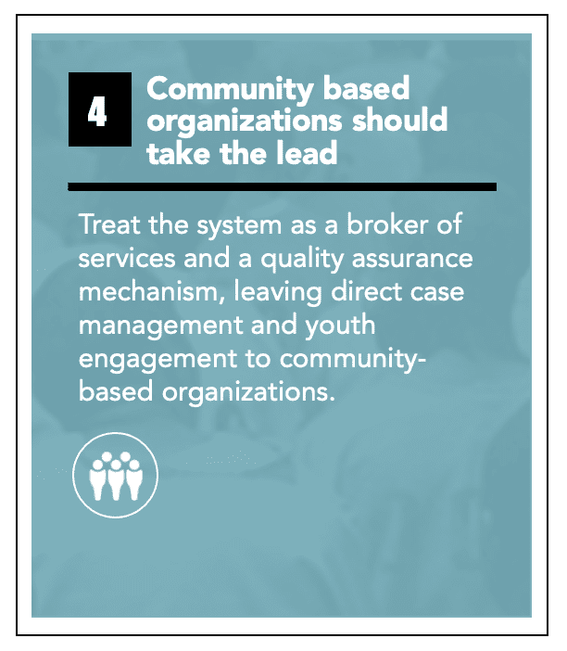
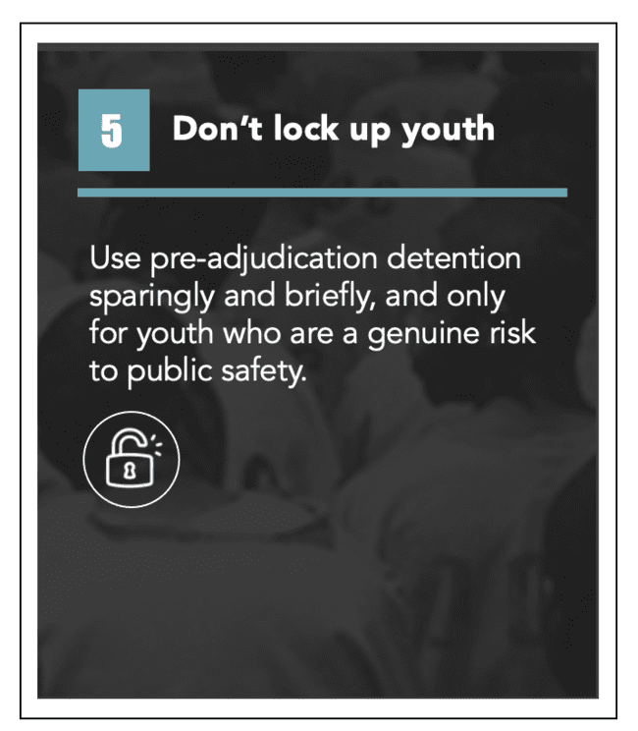
A Positive Youth
Justice System
Notes:
DAVID slide

Slide 7
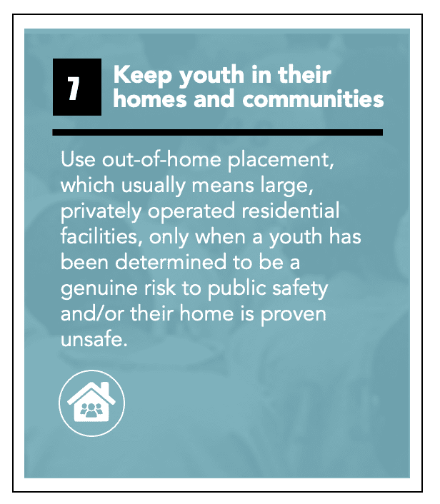
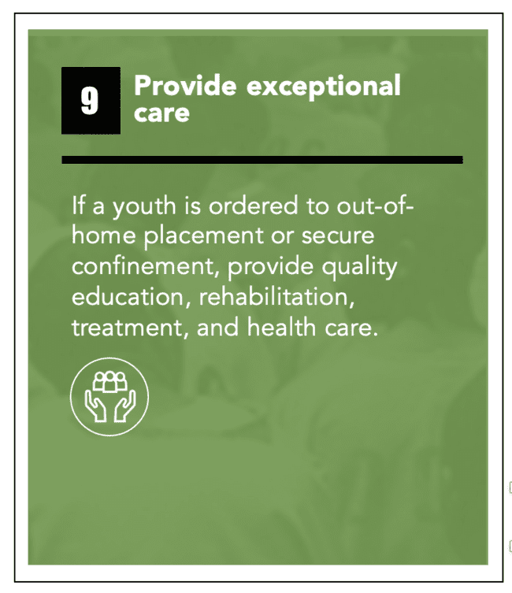
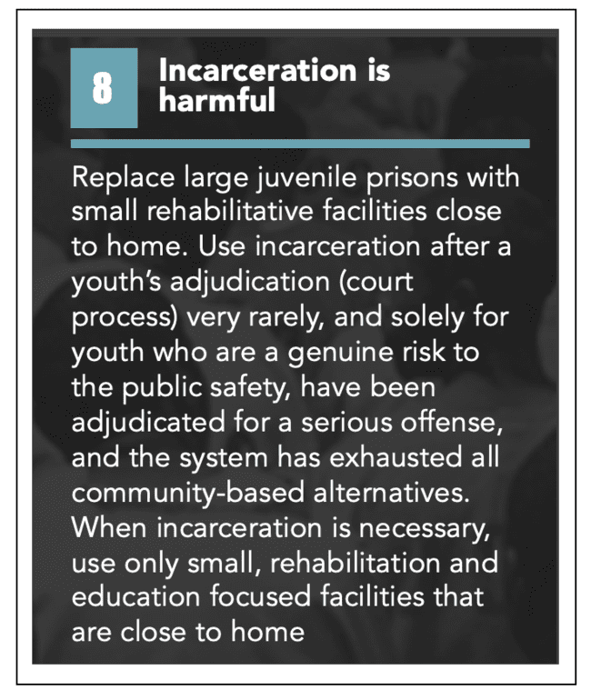
A Positive Youth
Justice System
Notes:
DAVID slide

Slide 8
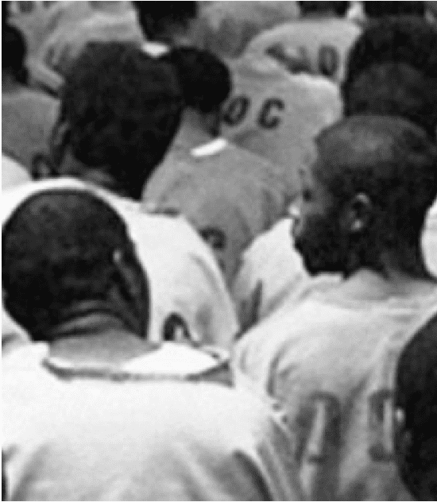


A Positive Youth
Justice System
2
Collaborate with youth and families
Develop youth case plans collaboratively with youth and family, and share ownership of the plan
Young people and their families are the best experts in their lives and experiences, and a collaborative approach in case plan development will produce greater investment and more positive outcomes.

Slide 9
A Positive Youth
Justice System
Collaborate with youth and families
The National Child Traumatic Stress Network
2
underscored the vital role families play in an issue brief on family engagement in the juvenile justice system, noting:
“When families are viewed and treated as partners in both their child’s care and in the operations of the juvenile justice system itself, the child, the family, and the system benefit. The most effective interventions for youth in the justice system are those that engage families in a strength-based partnership” (Rozzell, 2013).
Develop youth case plans collaboratively with youth and family, and share ownership of the plan

Slide 10
A Positive Youth
Justice System
Focus on needs and strengths
2
Collaborate with youth and families
For the far fewer youth who remain in the Youth Justice System, along with the risk assessment and trauma screening, assessments should be conducted of the youth’s needs and strengths.
Develop youth case plans collaboratively with youth and family, and share ownership of the plan
Team Meeting
The youth, their family, and system staff (who have been trained in PYD), should then meet to determine what the achievement plan will be for the youth and their family:
What services, supports and opportunities will the youth and family be connected with to address their needs and build on their strengths
Example
Washington, DC: Department of Youth Rehabilitation Services example of Youth/Family Team Meetings

Slide 11

Family-Engaged Case Planning Practice Guide
Written and released by the Annie E. Casey Foundation in February, the guide details a model of case planning that is family-focused, youth-centered and strength-based.
The guide covers the following:
Why family engagement is important — and a departure from status quo case planning.
Three stages of the family-engaged case planning model.
Advice on adapting this model to local jurisdictions.
Six common challenges to meaningfully engaging family.
Tools to support family-engaged case planning.
https://www.aecf.org/resources/family-engaged-case-planning

Slide 12


Credible Messengers & Intensive Life Coaching
People with similar lived experiences as the people they are serving. For instance, from the same neighborhood, formerly incarcerated, victim of gun violence, know their friends. Use that credibility to create a connection with the client.
“Credible Messengers are individuals who are able to connect with and motivate the most at-risk people to successfully challenge and transform destructive thinking, attitudes and actions” – Credible Messenger Justice Center
Intensive Life Coaching
Relationship First: Build a strong, trusting relationship between Life Coach (Credible Messenger) and participant
Mentality Shift: Change the mentality that gives rise to destructive decisions
Provide needed Services, Supports, & Opportunities
Notes:
DAVID slide

Slide 13
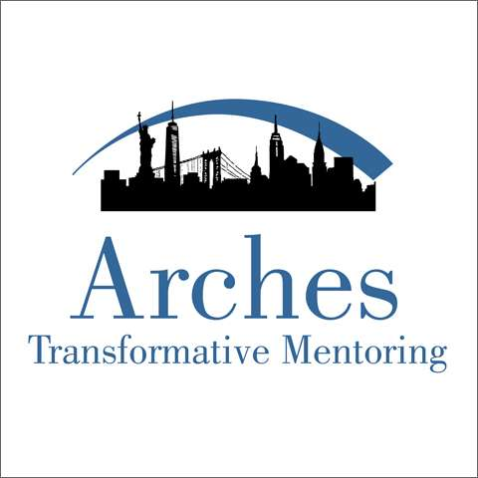


Credible Messenger Life Coach Models
In Development:
Alameda Co: 7-day per week in CMs in juvenile hall
Los Angeles Co
Notes:
DAVID slide

Slide 14
A Positive Youth
Justice System
From “Trail Em, Nail Em, and Jail Em” to Support & Development Them
Steps to Take:
Keep supervision length to as short as necessary
Reduce the conditions of probation to only those that are directly tied to the youth’s goals of rehabilitation and development.
Eliminate incarceration as a consequence for technical violations.
Juvenile justice systems should incentivize youth achievement.
A young person on probation should be able to earn time off of probation by achieving certain milestones, including significant academic improvement, high school graduation, program completion, etc.
These measures would help reduce the caseload and workload of Probation Officers and allow them to focus effort and resources where they are most needed.

