Slide 1
YOUTH JUSTICE
CREATING BETTER OUTCOMES FOR YOUTH

Slide 2
WHY THE JJDPA MATTERS
The JJDPA creates four core protections for young people
First enacted in 1974, it was reauthorized in 2018 to:
Strengthens provisions that address racial and ethnic disparities in the justice system.
Prohibits children who are awaiting trial in adult court from being held in adult facilities.
Limits the use of detention for children charged with status offense behaviors.
Protects girls from being shackled while giving birth.
Focuses on evidence-based and trauma-informed care.

Slide 3
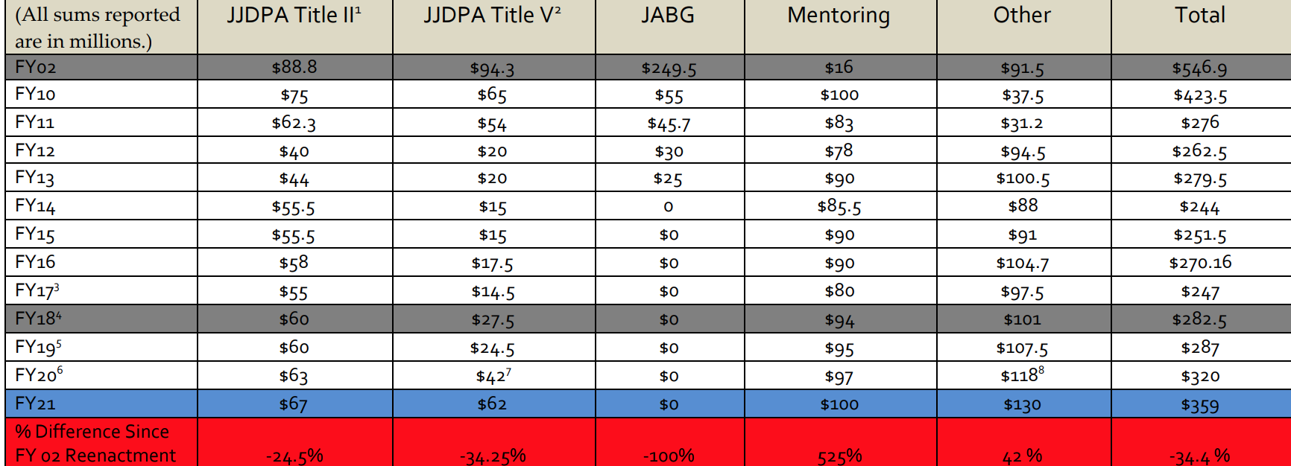
FEDERAL APPROPRIATIONS ARE KEY

Slide 4
TWO KEY ASKS:
Restore funding for juvenile justice programs (Title II, Title V, JABG)
Provide federal support for implementation of the JJDPA as reauthorized in 2018

Slide 5
JUVENILE JUSTICE IS MONEY WELL SPENT
  The JJDPA is cost-effective. Targeted investments in juvenile justice increase public safety, improve outcomes for youth and families, and result in more stable communities across the nation.
Title V
Title II
JABG
Better outcomes for youth, families and communities & cost savings for the Federal and State Government

Slide 6
JUVENILE JUSTICE AND DELINQUENCY PREVENTION ACT
The JJDPA ensures that our children, our families, and
our communities receive key protections.
Federal support is needed to help implement important
provisions of this legislation include jail removal which
goes into effect in December.

Slide 7


This Photo by Unknown Author is licensed under CC BY-SA

Slide 8
CONTACT INFORMATION
NAME
EMAIL@EMAIL.COM
(111)111-1234
NAME
EMAIL@EMAIL.ORG
(111)111-1234

